Slide 1
Final Presentation - Master Thesis
CPM Remote
Ruizhang Zhou supervised by Jianye Xu and Armin Mokhtarian
25.04.2024
AI-Based Generation of Testing Scenarios for Motion Planners of Connected and Automated Vehicles
Notes:
Thank you very much and welcome to my final presentation.
My name is Ruizhang and I have been working on scenario generation in my master thesis.
My thesis is part of the CPM Remote project and was supervised by Jianye Xu and Armin Mokhtarian.

Slide 2
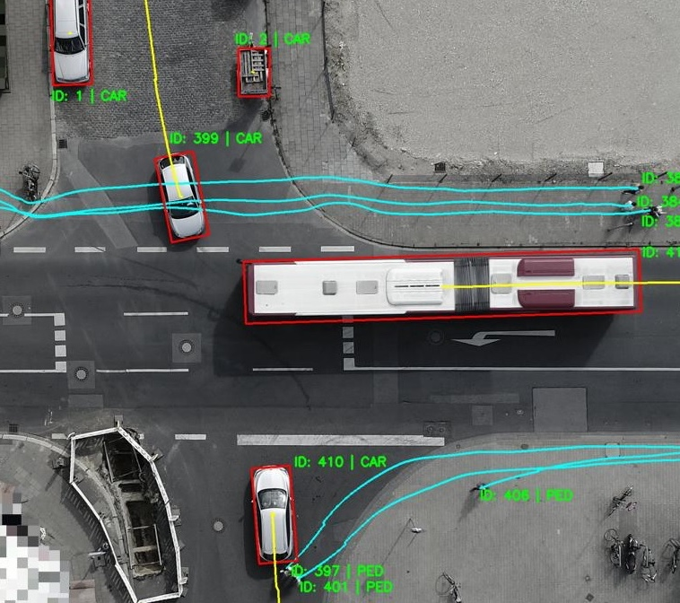
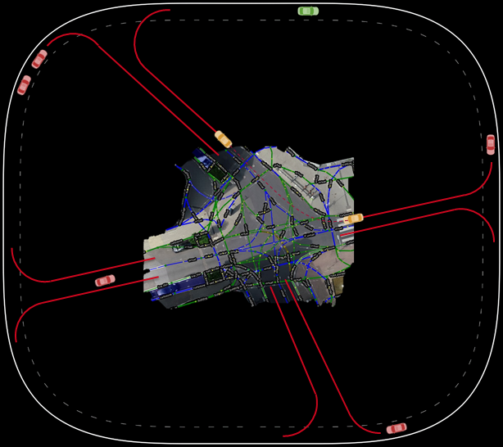
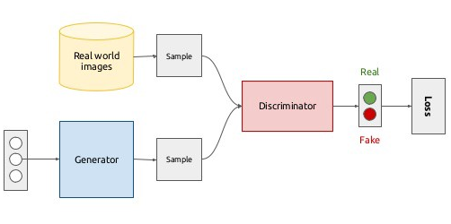
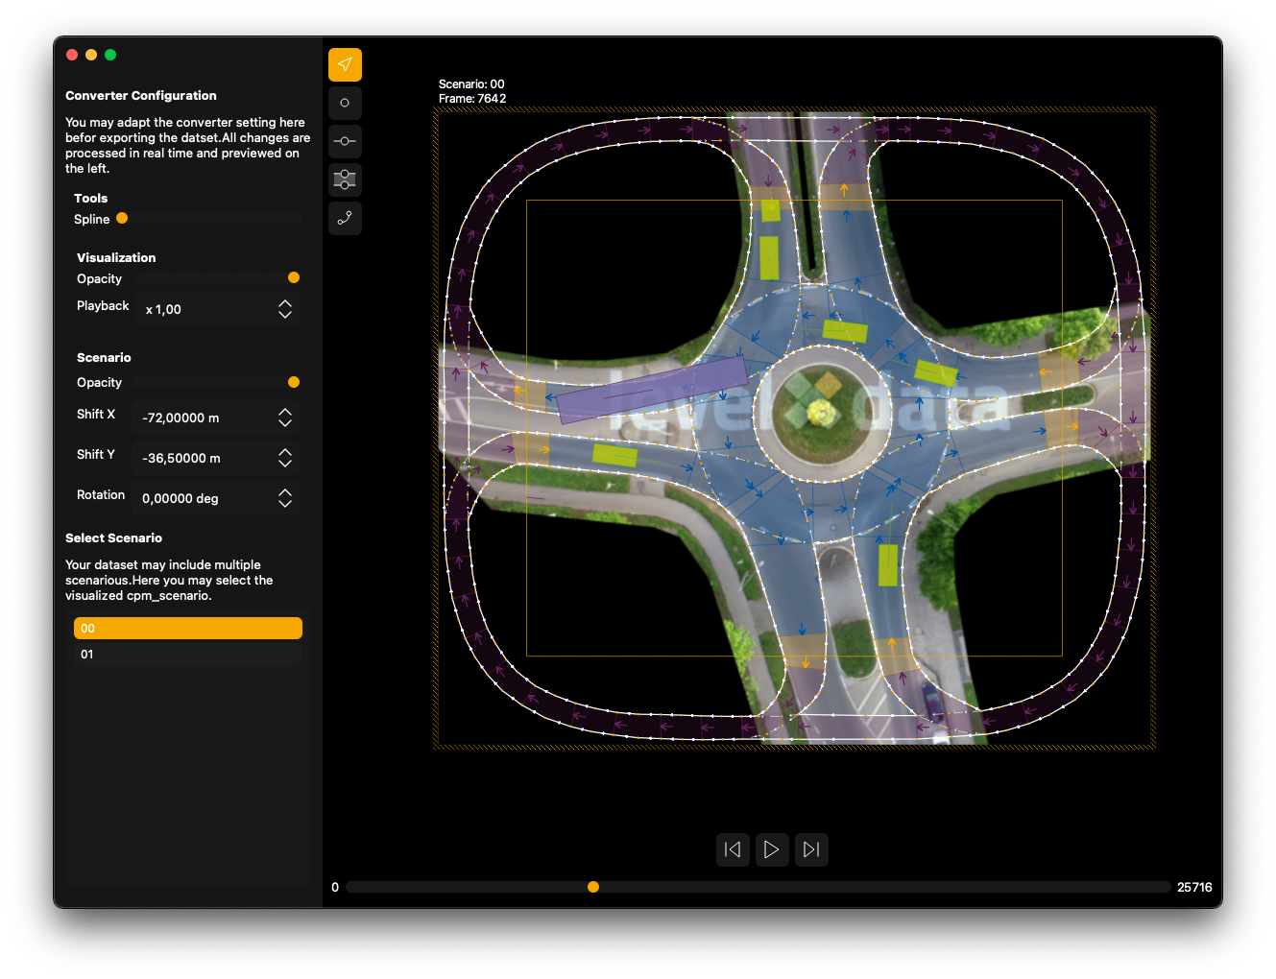
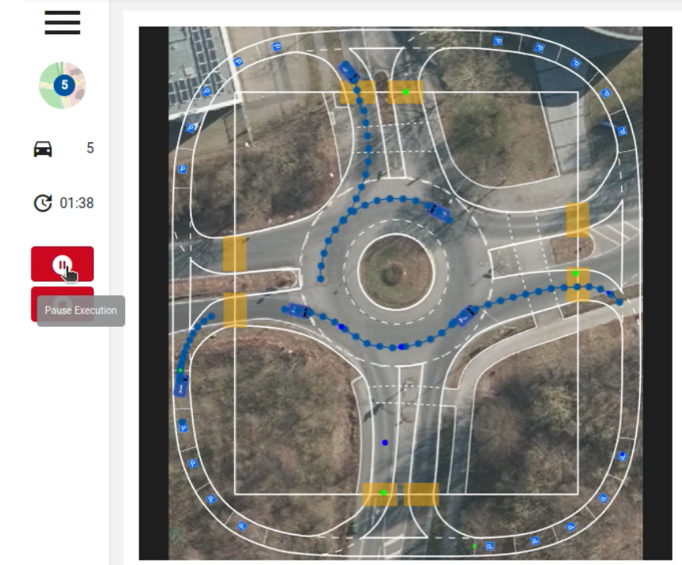
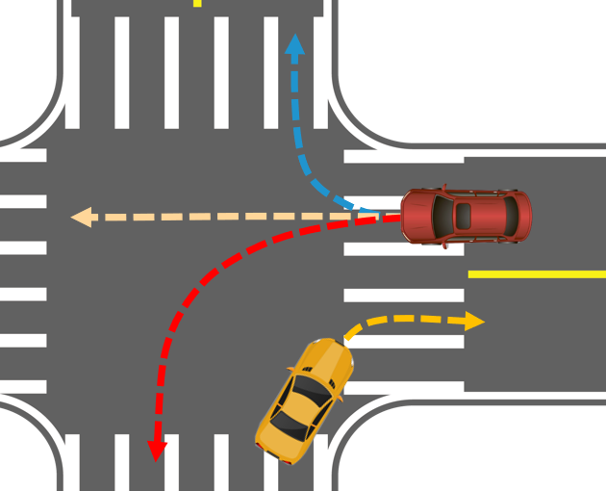
Overview
AI-based generation
Evaluation
Integrate into CPM Remote
Notes:
Motivation: Data comes from real world, and is hard to get and sometimes not open. One workaround for this difficultly would be to create sufficiently realistic synthetic data. This synthetic data could then be used to reproducibly develop and train machine learning models, enabling better experiments, and ultimately better models for connected autonomous vehicles.

Slide 3




Agenda
AI-based models
Generative Adversarial Network (GAN) / Time-series GAN (TimeGAN)
Denoising diffusion probabilistic models / Diffusion Time-Series (Diffusion-TS)
Implementation
Preprocess the real-world data to time series test cases
Adjust the AI-based framework to generate fake test cases
Evaluation of the generations
Qualitative analysis: Visualization
Quantitive analysis: Data Distributions
Integration into CPM Remote
Convert the test cases into XML for CPM Remote
Merge the test cases into CPM Remote

Slide 4
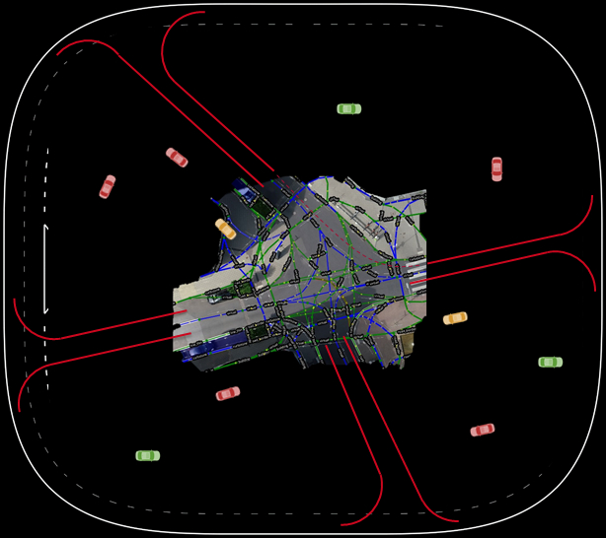
Generative Adversarial Network (GAN)
Real test cases
Real
Discriminator
Random noise
Generator
Fake
Fake test cases
Goodfellow, Ian, et al. "Generative adversarial nets." Advances in neural information processing systems 27 (2014).

Slide 5
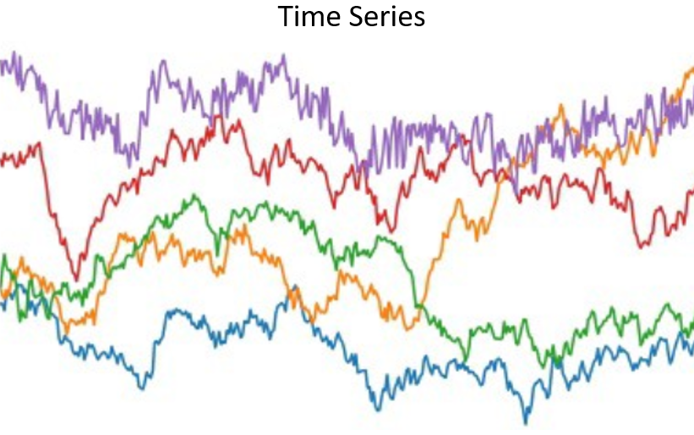
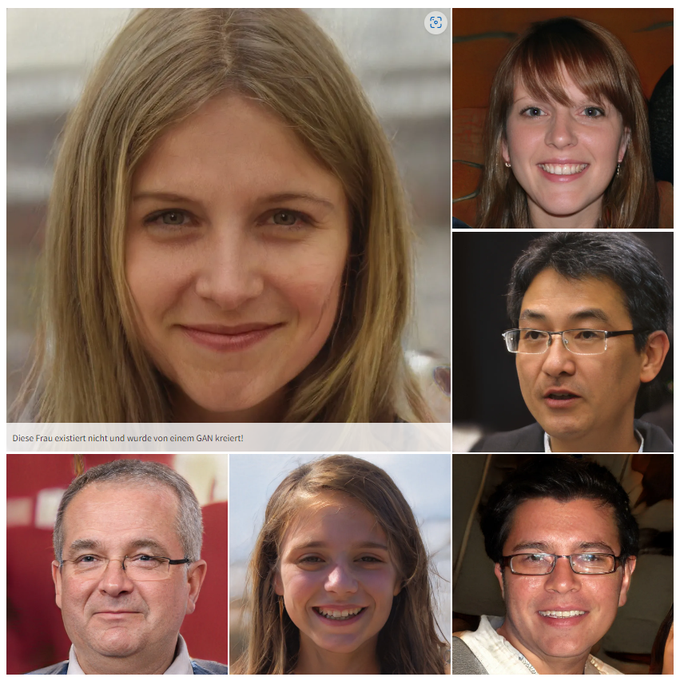
Image vs Time series
Image
https://thispersondoesnotexist.com
https://michael-fuchs-python.netlify.app
Notes:
利用GAN生成合成时间序列数据，所面临的挑战要大于利用GAN生成合成图片。除了学某个时间点之下的单个feature的分布,还要学各个feature之间的关系。
一个与image很大的差别是尺寸不是固定的(每个case 车的数量不一样 每辆车出现在case中的frame也不一样)
RecurrentGANs的做法是对每个时间点的特征分布建模，相应的，其loss也仅仅是简单的将每个时点的loss相加，这种训练方法是不足以捕获序列相关性的。

Slide 6
Time-series generative adversarial networks (TimeGAN)
Autoencoder Network
Supervised Loss
Adversarial Network
Reconstruction Loss
Unsupervised Loss
Reconstructed Time Series
Time Series Classification
Recovery
Discrimination
RNN
Latent Space
RNN
RNN
Real Time Series
Embedding
Generation
Random Time Series
Yoon, Jinsung, Daniel Jarrett, and Mihaela Van der Schaar. "Time-series generative adversarial networks." Advances in neural information processing systems 32 (2019).
Notes:
这种框架同时结合了监督学习和无监督学习，以解释时间上的相关性。这个模型在学习时间序列的内生空间(a time-series embedding space)时，同时对监督学习和对抗训练这两个目标进行优化。结合了非监督学习的范式灵活的特点和监督学习对于训练过程控制力强的性质，让TimeGAN模型能够把各个feature之间的关系考虑进模型中。
intermediate part
TimeGAN的两个网络及其所包含的四个部分
自编码器：含有内在和复现网络(embedding and recovery networks), 自编码器可以理解为一个试图去还原其原始输入的系统。
对抗网络：包含序列生成器和序列判别器
它是一种联合训练，即依靠三个不同的loss function对自编码器和对抗网络进行训练。Reconstruction Loss用于自编码器参数的优化，Unsupervised Loss用于对抗网络参数的优化，而Supervised Loss则是针对于生成器对feature之间关系的学习。
具体来说，自编码器的embedding network致力于创造出潜在空间，而对抗网络则在潜在空间里进行操作，最后Supervised Loss则要让合成数据的features之间的关系尽可能向想真实数据靠拢。（Specifically, the self-encoder's embedding network works to create the latent space, while the adversarial network operates in the latent space, and finally the Supervised Loss seeks to make the relationships between the features of the synthesized data as close as possible to the wanted real data.）
对抗网络要学习的对象——潜在空间不是静止的，而是随着学习过程动态变化的，因为潜在空间是由自编码器的内在网络生成的，随着合成序列的生成，自编码器也在学习，故它所创造的潜在空间也会变化。
因此训练的进行分为三个阶段
利用真实时间序列数据训练自编码器以优化重构过程。
利用真实时间序列数据优化supervised loss以捕获历史数据中的features之间的关系
联合训练

Slide 7
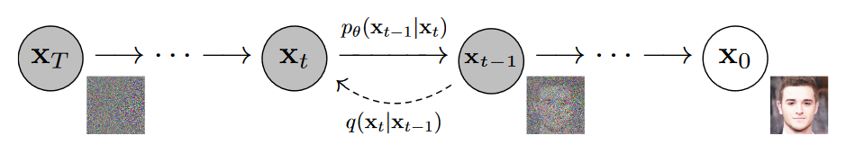
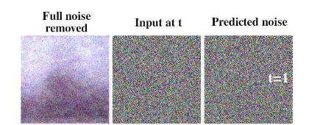
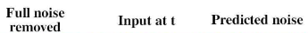
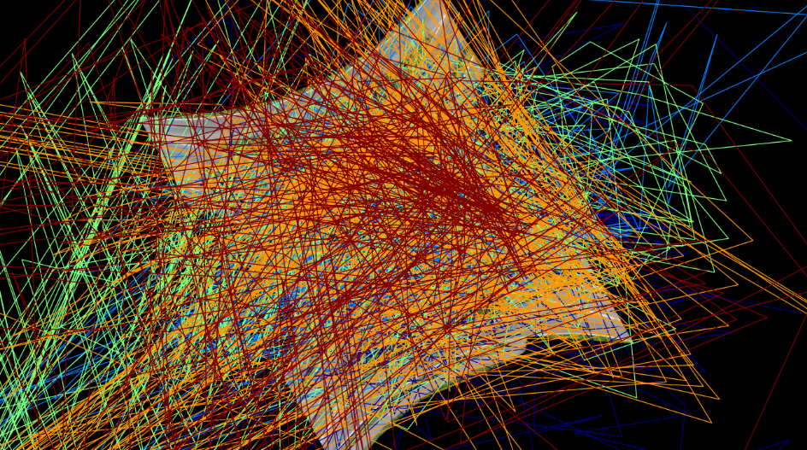
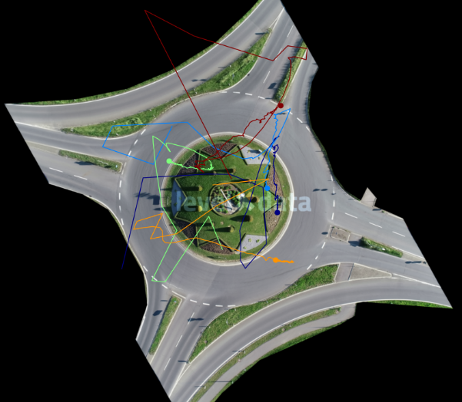
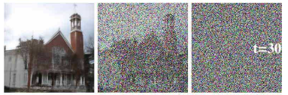
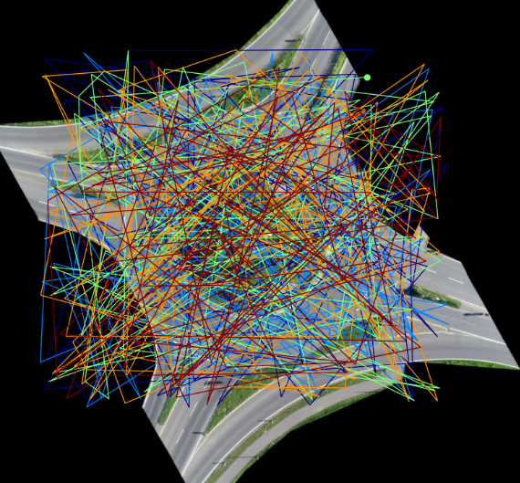
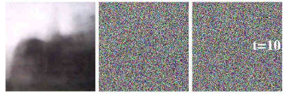
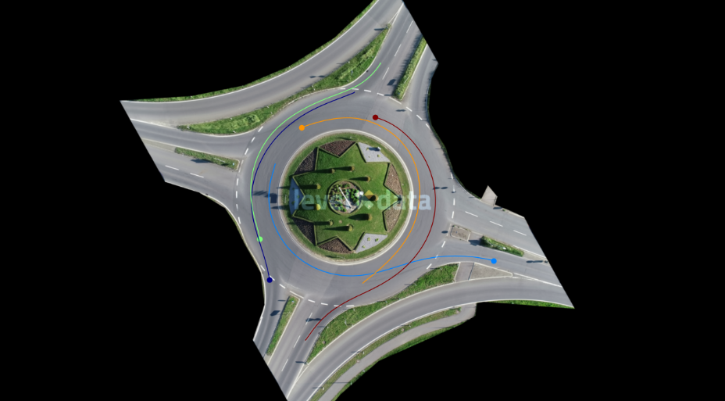
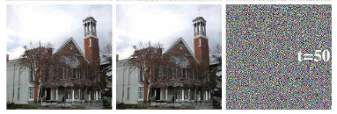
Denoising diffusion probabilistic model (Diffusion Model)
Step by Step visual introduction to Diffusion Models. - Blog by Kemal Erdem
Ho, Jonathan, Ajay Jain, and Pieter Abbeel. "Denoising diffusion probabilistic models." Advances in neural information processing systems 33 (2020): 6840-6851.
Notes:
提一下我试着在timeGAN上调试了很久，最多只能在10s1辆车上得到还不错的生成轨迹。
最后发现普通的GAN一个比较大的问题在于它的Generator, It is extremely difficult to train a network to convert some random noise directly into a meaningful result.
So -> multistep framework
the goal of the reverse diffusion process is to convert pure noise into an image.
虽说model是step by step移除噪音的,但在实际操作的时候有个公式可以一步到位,一起移除n步噪音

Slide 8
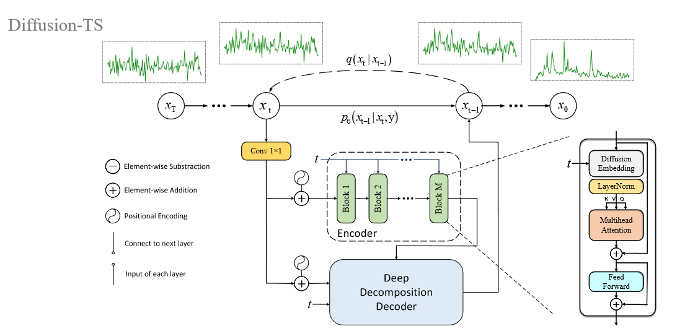
Diffusion Time-Series (Diffusion-TS)
Overall Framework
Yuan, Xinyu, and Yan Qiao. "Diffusion-TS: Interpretable Diffusion for General Time Series Generation." arXiv preprint arXiv:2403.01742 (2023).
Notes:
整体是Encoder-Decoder的架构
Encoder的blocks是一个接一个连接在一起的: Encoder‘s blocks are connected one to the other. 每个Block其实就是用了Transformer的架构。由于时间关系Transformer就不展开讲了。

Slide 9
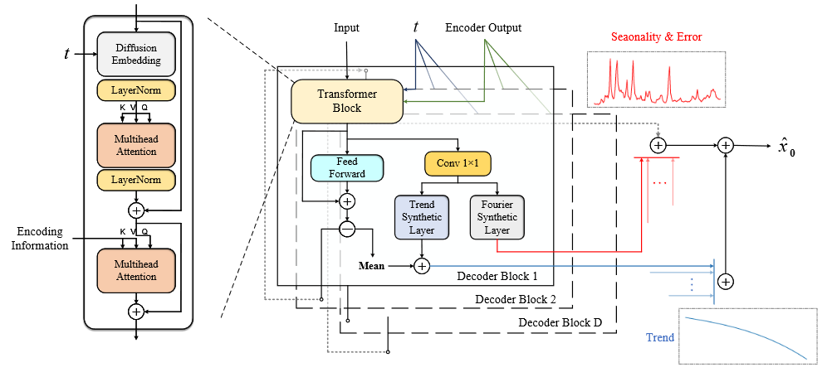
Diffusion Time-Series (Diffusion-TS)
Decoder Part
Yuan, Xinyu, and Yan Qiao. "Diffusion-TS: Interpretable Diffusion for General Time Series Generation." arXiv preprint arXiv:2403.01742 (2023).
Notes:
This is the structure of the decoder part. Unlike the encoder part, hier decoder blocks get the inputs seperately and add the outputs of different blocks together in the end to get the final output. And besides the transformer block, the decoder has two another layer specifically designed for the time series datas, the trend synthetic layer and the fourier synthesic layer. The trend layer is for the long term patterns, and the seasonality or we can also understand as short-term periodic patterns and some small noice errors at some random time stamps.

Slide 10
Agenda
AI-based models
Generative Adversarial Network (GAN) / Time-series GAN (TimeGAN)
Denoising diffusion probabilistic models / Diffusion Time-Series (Diffusion-TS)
Implementation
Preprocess the real-world data to time series test cases
Adjust the AI-based framework to generate fake test cases
Evaluation of the generations
Qualitative analysis: Visualization
Quantitive analysis: Data Distributions
Integration into CPM Remote
Convert the test cases into XML for CPM Remote
Merge the test cases into CPM Remote
Notes:
ganze funktioniert

Slide 11
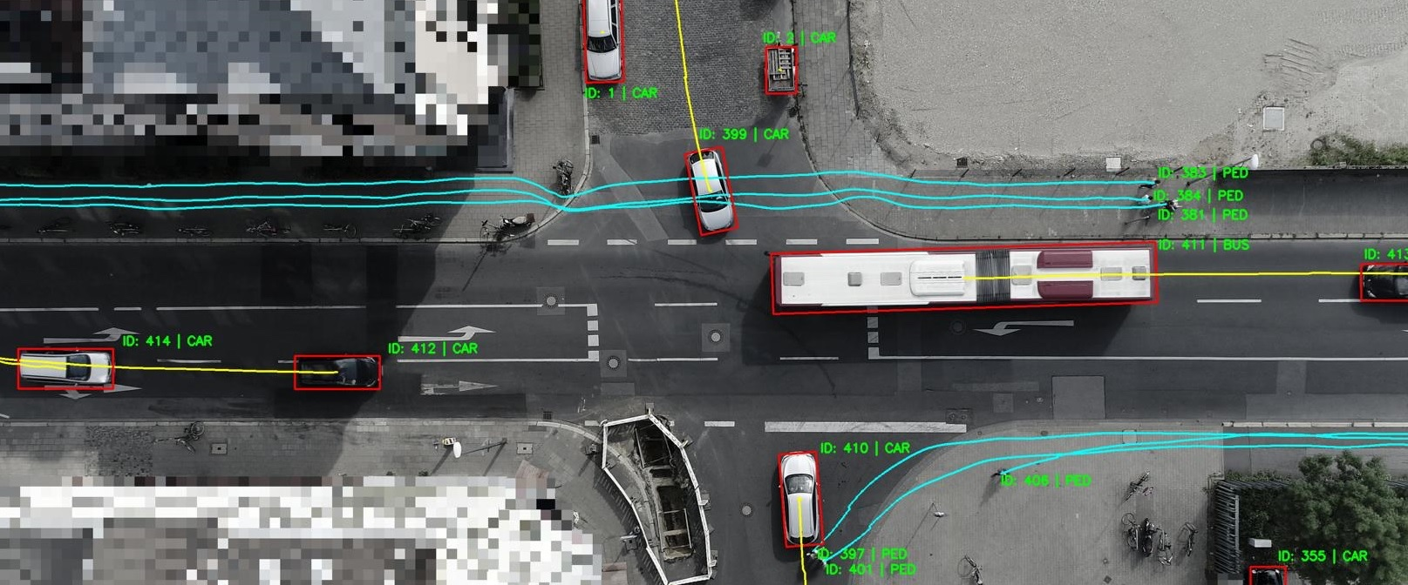
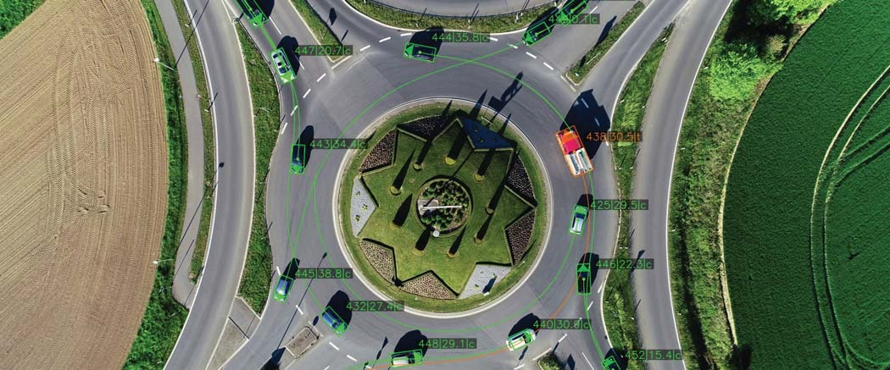
Training Datasets
Drone data sets with naturalistic road user behaviour
Bird eye view
10cm accuracy
Intersection Data Set (inD)
10 hours
4 locations
Roundabout Data Set (rounD)
6 hours
3 locations
Exit Data Set (exiD), Highway Data Set (highD), University Data Set (uniD)
License: Custom (Free for use for non-commercial applications)
inD dataset
Bock Julian, The inD Dataset: A Drone Dataset of Naturalistic Road User Trajectories at German Intersections, 2019
Krajewski Robert, The rounD Dataset: A Drone Dataset of Road User Trajectories at Roundabouts in Germany, 2020
Moers, Tobias, et al. "The exid dataset: A real-world trajectory dataset of highly interactive highway scenarios in germany." 2022 IEEE Intelligent Vehicles Symposium (IV). IEEE, 2022.
rounD dataset
revised from Simon Schäfer‘s slide
Notes:
我主要是针对于inD和rounD进行实验,以它们两个去构成训练数据，生成假的数据。
exiD和highD是由于太简单了,几乎只有车辆直行,变道的情况,没有会车的情况,所以作为我们的testcases太为简单了,我之后也有生成相关的数据,我们等会也可以看到。
而uniD的道路也不太标准，生成的map也不太通用，且行人与自行车太多

Slide 12
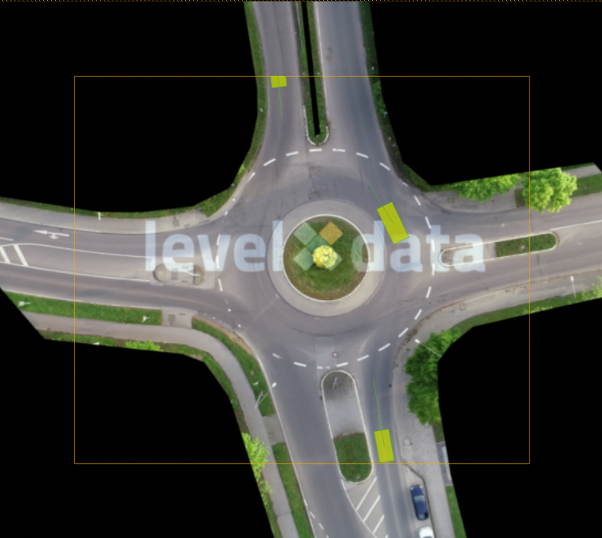
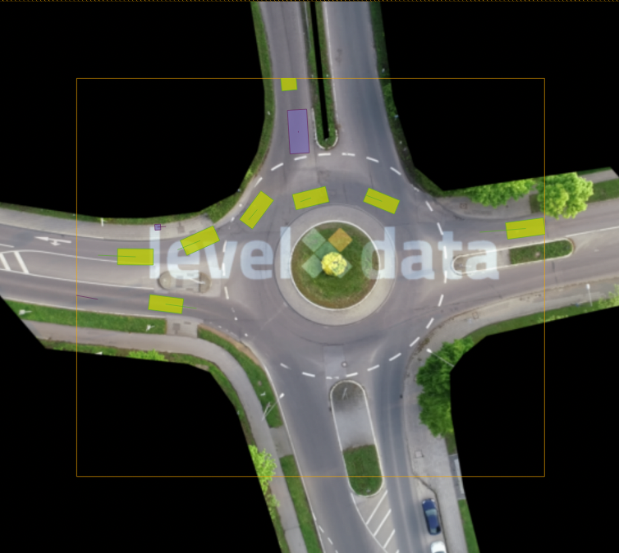
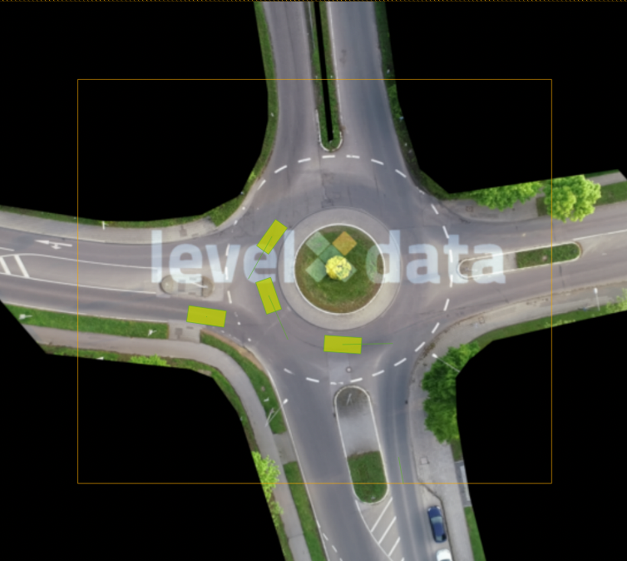
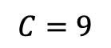
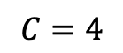
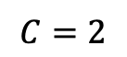
Scenarios size and difficulty
Size of the test cases
case length 500 frames (20 seconds) with 5 tracks (cars, trucks, bicycles,…)
too long : too much padding values, hard to distinguish between normal and abnormal values
too short : not include complete trajectories of vehicles
$$C=2$$
$$C=9$$
$$C=4$$
Easy
Hard
Medium
revised from Simon Schäfer‘s slide
Notes:
我选500个frame为20s也是因为500个frame大概能包括大多数的车辆从进入到出去这个场景, 车辆的平均frame为三四百, 那么500个frame大概就正好可以作为一个单位,能包含几乎所有的情况,同时更长的cases也可以通过这个来组合而成

Slide 13
Data preprocess
Features
Only the positions of tracks (x,y coordinates).
velocity and orientation informations implicitly included.
Sliding window size between cases: 100
too small : too much replicated cases, increased training costs
too big : loss of data diversity
“Challenging“ test cases
use the density filter ( track length > 90% case length)
if more than 5 tracks, rank the tracks by the track length
According to the map seperately build the training data
Case
0
1
…
498
499
Case
100
101
…
598
599
Case
20000
20001
…
20498
20499
…
…
Sliding Window
Notes:
Data Preprocess其实虽然说是前阶段的准备工作,但其实训练数据的质量直接决定了生成数据的质量, 我需要从源数据中尽可能多地获取多样的有用的数据
当然我也尝试了其它的size of case, 通常在我们这个inD和rounD的数据集中一般的vehicle都是15s左右的出现时间，即300-400frames

Slide 14
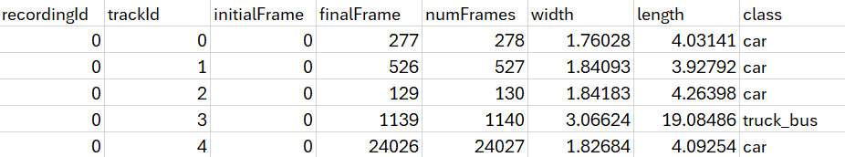
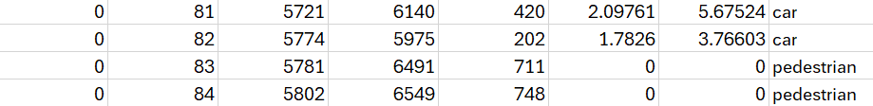
Data preprocess
recordingMeta.csv
25 * 961.08 = 24027 frames
tracksMeta.csv
filter the abnormal tracks with too long Frames
filter the „pedestrians“
row_pointer for tracks.csv
Notes:
Data Preprocess其实虽然说是前阶段的准备工作,但其实训练数据的质量直接决定了生成数据的质量, 我需要从源数据中尽可能多地获取多样的有用的数据

Slide 15
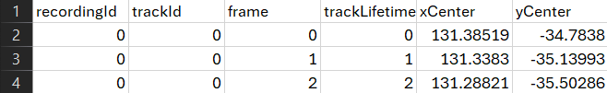
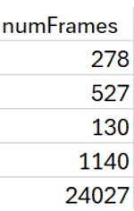
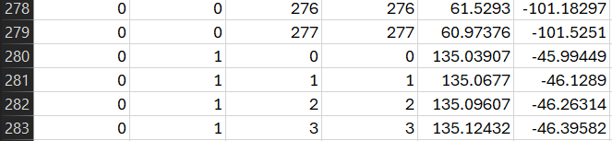
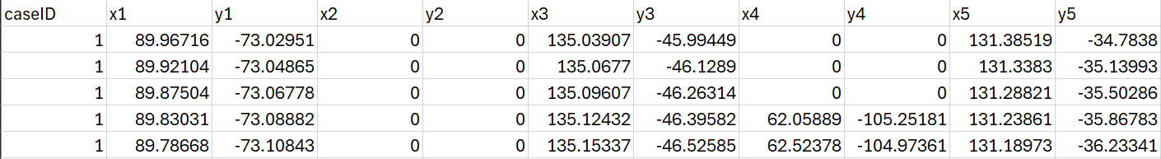
Data preprocess
tracks.csv
test case
frame 0-499: Case 1: Track IDs: [3, 7, 1, 6, 0]
frame 100-599: Case 2: Track IDs: [3, 7, 1, 8, 9]
…

Slide 16
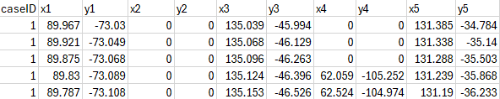
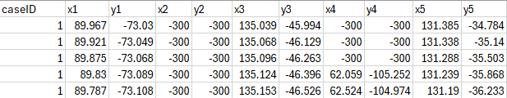
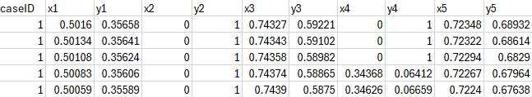
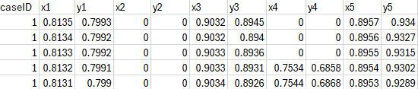
Normalization
0 as padding value
extrem value as padding value
min max normalization
Notes:
extrem value通常我会选取小于两三倍最小的真实值来作为padding value，比如这个case我就会选取-300
我其实还尝试用真实值作为padding value，但反而生成的结果不好且不稳定，且最后很难分辨并排除掉这些添加的padding value

Slide 17
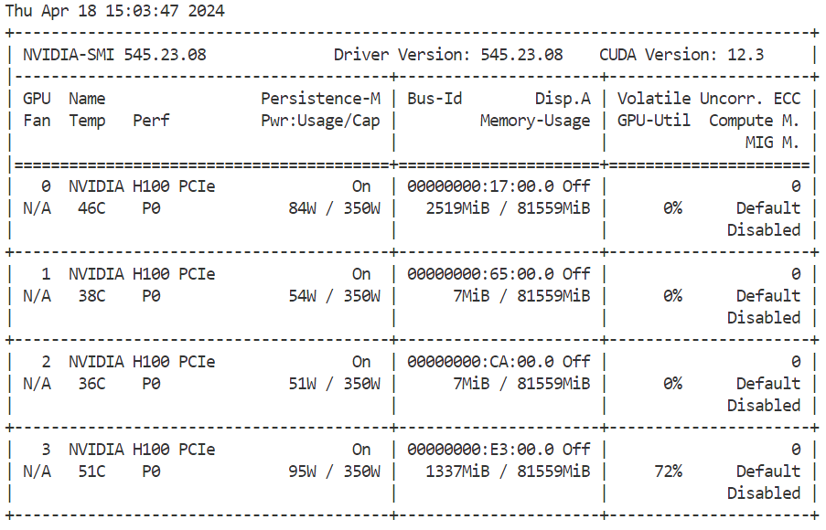
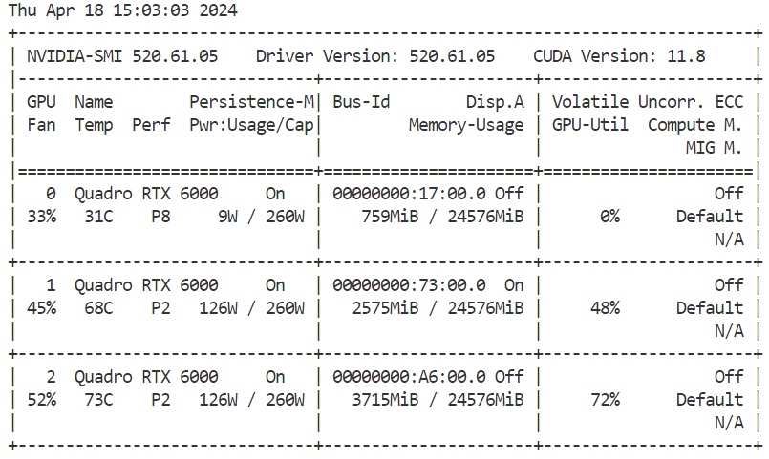
Implementation
Training
Hardware: NVIDIA H100 / Quadro RTX 6000
Software: Python (Pytorch)

Slide 18
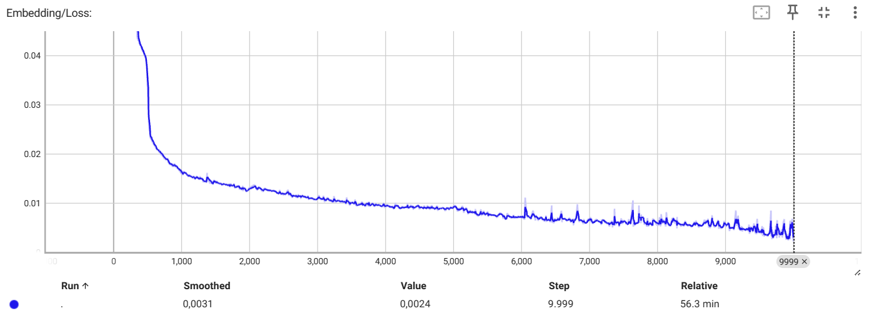
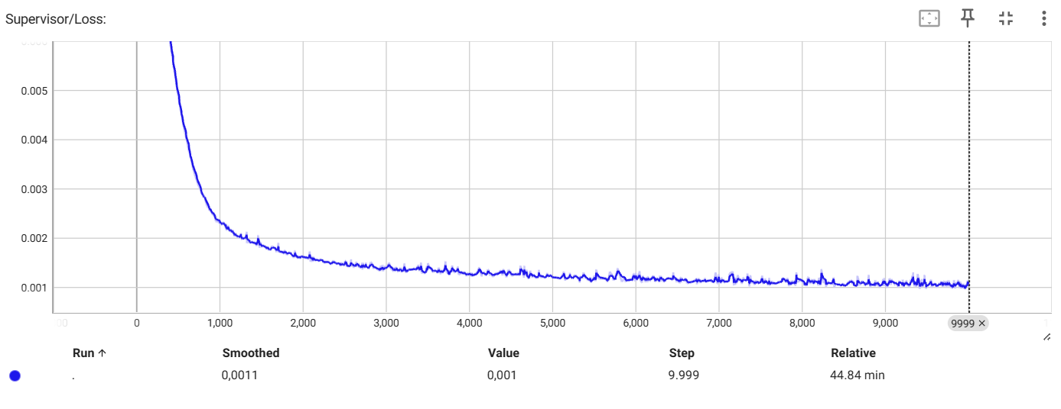
Implementation - Training Process – TimeGAN
Embedding Loss
Supervised Loss
Notes:
这里对loss的可视化我是用的tensorboard工具

Slide 19
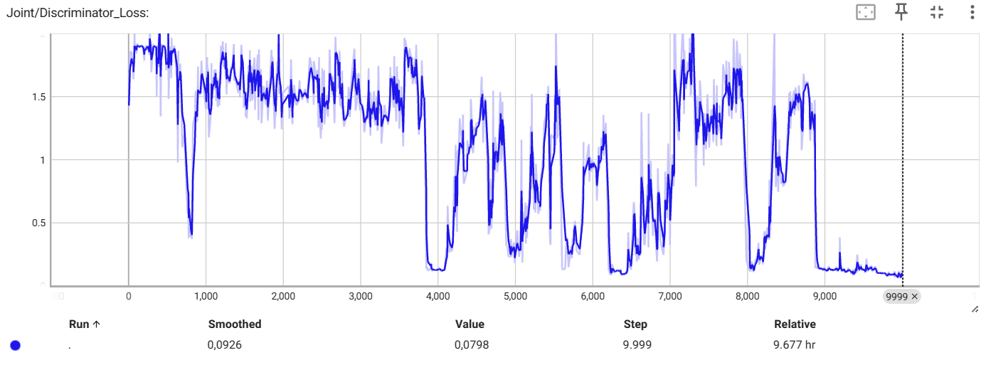
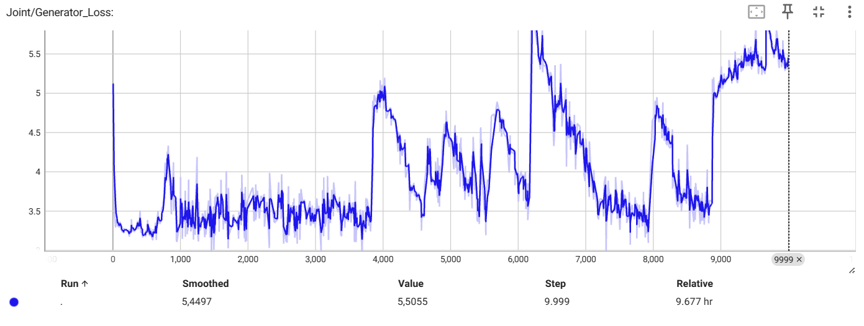
Implementation - Training process – TimeGAN
Discriminator Loss
Generator Loss
Notes:
训练过程不稳定: Discriminator和Generator的损失曲线出现剧烈波动
鉴别器（Discriminator）和生成器（Generator）的损失确实往往呈现出一种反相关关系，并且可能会出现周期性的变化。这是因为GAN的训练过程本质上是一个两个网络之间的对抗过程
没有单一的损失值可以直接指示GAN的最优模型。选择最优模型通常需要综合考虑生成质量、损失平衡以及训练过程的稳定性。

Slide 20
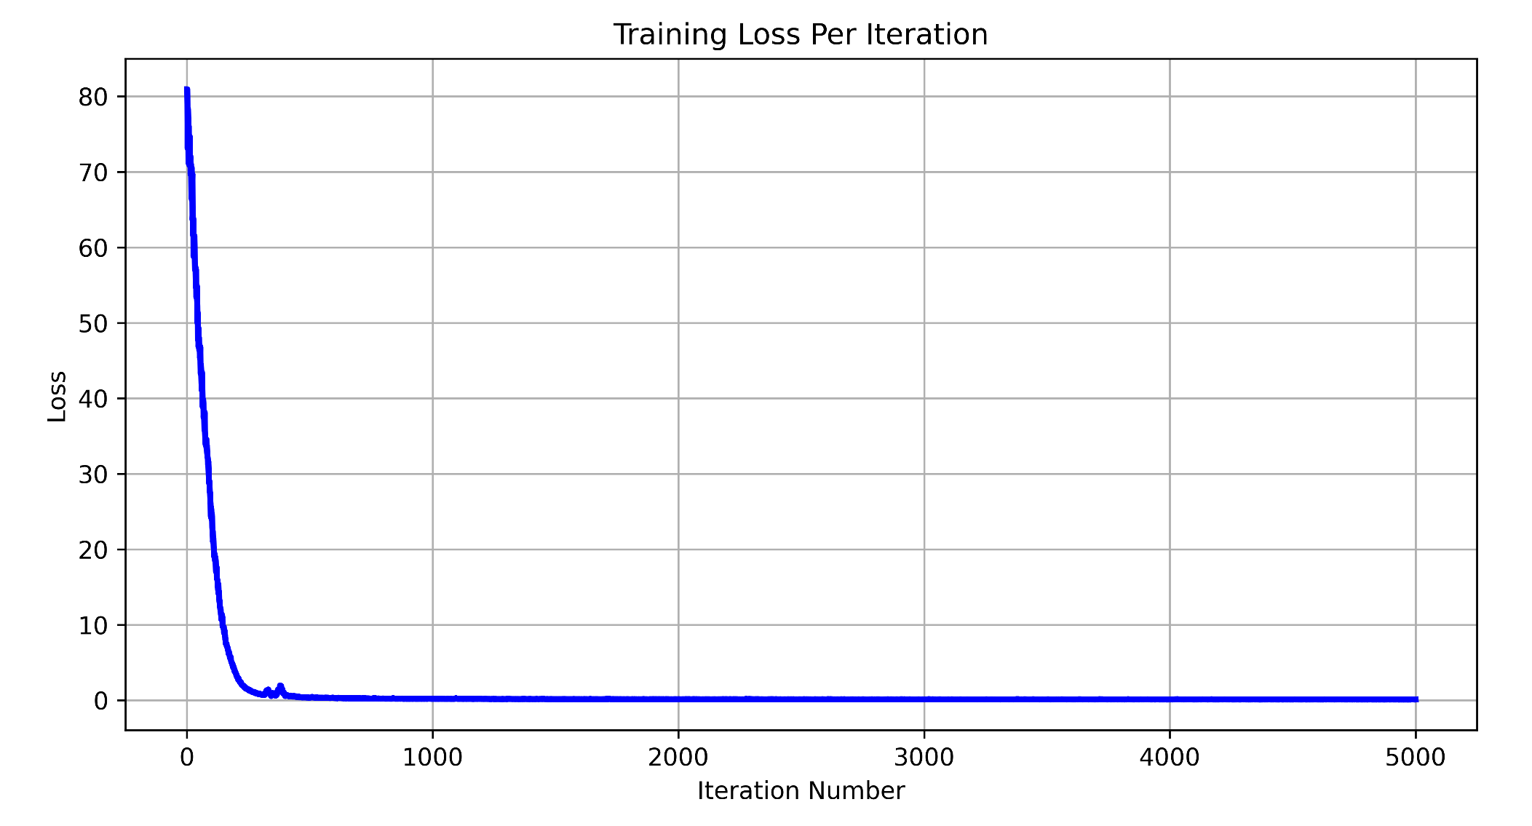
Implementation - Training process – Diffusion-TS
Training on rounD map 09-23, 500 frames (20s), 5 vehicles, -300 as padding value as example
Loss：
Mean Square Error (MSE)
Notes:
而这里的loss我就是自己根据记录的loss画了一张loss变化的曲线图
One of the differences between the training process of TimeGAN and Diffusion-ts is that There‘s only one Loss in Diffusion-TS, it‘s easy to check when the training has converged and we can stop the training process. But for the TimeGAN, there‘re different losses. And Especially the loss between generator
提一嘴 diffusion-ts比起timeGAN更快收敛, 大概训练时间就是五个小时
格式
这边diffusion-ts的loss就和diffusion

Slide 21
Agenda - Objective of this thesis
AI-based models
Generative Adversarial Network (GAN) / Time-series GAN (TimeGAN)
Denoising diffusion probabilistic models / Diffusion Time-Series (Diffusion-TS)
Implementation
Preprocess the real-world data to time series test cases
Adjust the AI-based framework to generate fake test cases
Evaluation of the generations
Qualitative analysis: Visualization
Quantitive analysis: Data Distributions
Integration into CPM Remote
Convert the test cases into XML for CPM Remote
Merge the test cases into CPM Remote
Notes:
To assess the quality of generated data, we observe three desiderata: (1) diversity—samples should be distributed to cover the real data; (2) fidelity—samples should be indistinguishable from the real data; and (3) usefulness—samples should be just as useful as the real data when used for the same predictive purposes (i.e. train-on-synthetic, test-on-real).

Slide 22
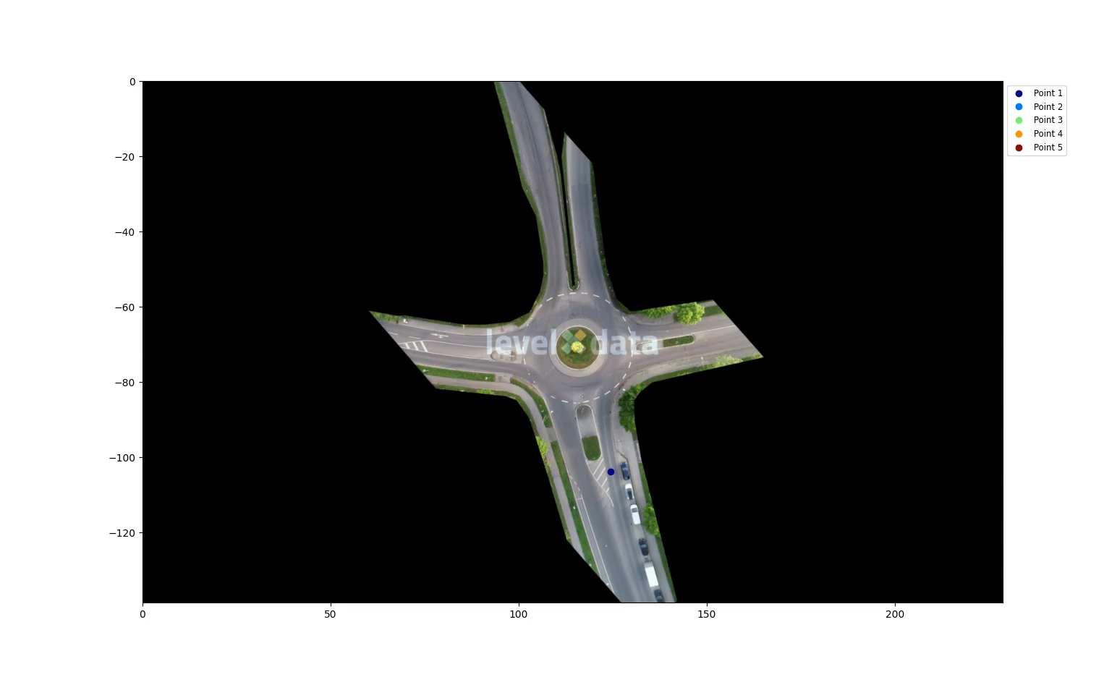
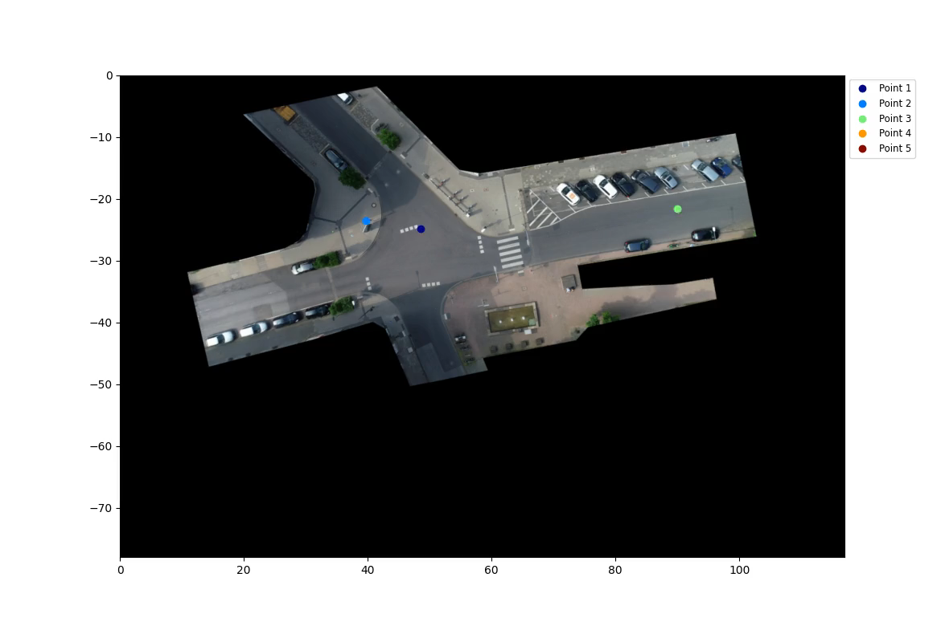
Qualitative Analysis - Visualization
Notes:
这是两个在inD和rounDmap上训练出来的生成结果的可视化
生成的数据集的大小是与训练的数据集的大小所匹配相当的, 训练的数据集样本更大更多样化，那么生成的数据集也会更大更多样化。一般情况下比如我这边的训练数据集中每张地图大约都有几千到一万左右的test cases，那么生成的test cases也是有大概几千到一万左右
inD有点tremble(抖动) and unstable

Slide 23
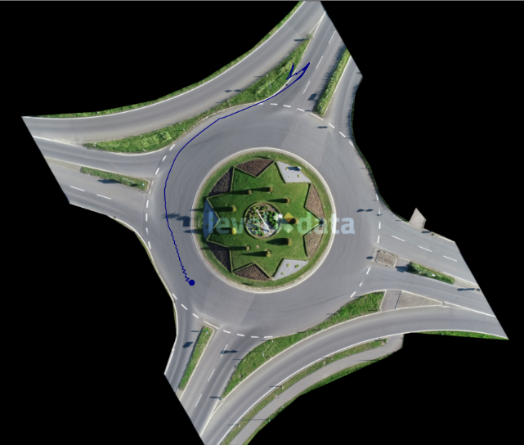
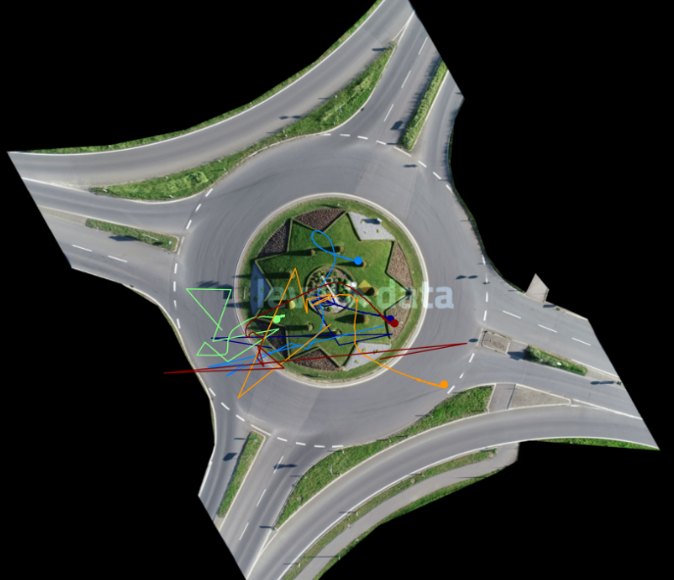


TimeGAN vs Diffusion-TS (on one same rounD map as example)
TimeGAN
Diffusion-TS
1 vehicle 10s
5 vehicles 10s

Slide 24



Diffusion Models - TS
Visualization on different datasets
inD
rounD
exiD
Notes:
在timegan上苦苦难以训练出decent的结果之后, 并且在初步比较了timeGAN和Diffusion TS之后, 我就主要将精力放在了对Diffusion-ts的训练上了。我用Diffusion-ts上测试了多个inD和rounD，以及也在exiD上测试了一些，并直接把testcases扩大到了20s（500 time frames）

Slide 25



Quantitive Analysis
Visualize the original and synthetic data distributions
Principal component analysis (PCA)
linear dimensionality reduction technique
multiple features to 2 dimensions for visualization
t-distributed Stochastic Neighbor Embedding (tSNE)
statistical method - visualizing high-dimensional data
probability distribution over pairs of high-dimensional objects
minimizes the Kullback–Leibler divergence
Density analysis
normalized data value
data distributions
Wold, Svante, Kim Esbensen, and Paul Geladi. "Principal component analysis." Chemometrics and intelligent laboratory systems 2.1-3 (1987): 37-52.
Van der Maaten, Laurens, and Geoffrey Hinton. "Visualizing data using t-SNE." Journal of machine learning research 9.11 (2008).
Density analysis of Diffusion-TS on rounD dataset
Notes:
首先generator models生成的数据是和训练数据量相当的，这样我们也能判断生成的数据是不是如训练数据一样多样化。
For visualization of the Principal component analysis，I retain the two most dominant components also means that the data will be reduced from the original high-dimensional space to a two-dimensional space,
statistical method for visualizing high-dimensional data by giving each datapoint a location in a two or three-dimensional map
The t-SNE algorithm comprises two main stages. First, t-SNE constructs a probability distribution over pairs of high-dimensional objects in such a way that similar objects are assigned a higher probability while dissimilar points are assigned a lower probability. Second, t-SNE defines a similar probability distribution over the points in the low-dimensional map, and it minimizes the Kullback–Leibler divergence (KL divergence) between the two distributions with respect to the locations of the points in the map.
最后是对data distributions的直接可视化，我是将所有坐标值，包括异常值用minmax都映射到0-1之间，然后再进行训练
这些方法生成的坐标值-5到5或-10到10只是数据在新特征空间中的相对位置。这些值的绝对大小不是最重要的；更重要的是点之间的相对位置和距离，它们反映了数据的内在结构。

Slide 26






Comparison between models
Original and synthetic data distributions on rounD 10 seconds 1 vehicle
TimeGAN
Diffusion-TS
Notes:
当然用diffusion-ts训练10 seconds 1 vehicle的数据就有点大材小用了,但我训练一下,用来对比一下和timeGAN的区别
看一下这个数字是干嘛的

Slide 27









Diffusion-TS - Data distributions on different datasets 500 frames (20s) 5 vehicles
inD
rounD
exiD

Slide 28
Result summary
Complexity in Learning Different Track Types:
Irregular paths, challenging learning (pedestrians, bicycles).
Predictable paths, simpler learning (cars).
Impact of Increasing Vehicles:
More vehicles increase feature dimensions, complicating learning.
Comparison Between Generative Models:
Diffusion models: Easier training, better convergence, superior data overlap.
TimeGAN: Comparatively harder to train and judge.
Performance Across Datasets:
exiD > rounD > inD: Reflects vehicular dynamics complexity.
highD and uniD: Too simplistic or complex for CPM Olympic test cases.
Notes:
Diffusion vs GAN
2. Stability of data generation
Diffusion Models generate new data by continuously diffusing the data, and this generation process is relatively stable. In contrast, the generation process of GAN is relatively unstable, and problems such as pattern collapse and pattern collapsing may occur. This makes Diffusion Models more advantageous in some tasks that require stable generation of results.
3. Solving the pattern collapse problem
GANs often suffer from pattern collapse in the generation process, i.e., the generated data is too concentrated on certain patterns and lacks diversity. In contrast, Diffusion Models generate data through the diffusion process, which can better avoid the pattern collapse problem and generate more diverse data.

Slide 29
Agenda
AI-based models
Generative Adversarial Network (GAN) / Time-series GAN (TimeGAN)
Denoising diffusion probabilistic models / Diffusion Time-Series (Diffusion-TS)
Implementation
Preprocess the real-world data to time series test cases
Adjust the AI-based framework to generate fake test cases
Evaluation of the generations
Qualitative analysis: Visualization
Quantitive analysis: Data Distributions
Integration into CPM Remote
Convert the test cases into XML for CPM Remote
Merge the test cases into CPM Remote

Slide 30









Data converter - spatial mapping
$$A=$$
$$+$$
$$+$$
81 m
4.5 m
$$A$$
72 m
4 m
revised from Simon Schäfer‘s slide
Notes:
Räumlichetransformation in das CPM Lab
Translation
Rotation
Skalierung
介绍一下data converter是干嘛的,是Simon Schafer弄的

Slide 31

Data set converter
Import data sets
inD
round
Replay of recordings
Define spatial transformation
Export/Import scenarios
revised from Simon Schäfer‘s slide

Slide 32


Data converter – csv to XML

Slide 33


Integration into CPM Remote
Files · dev_rzz · CPM / Project / Lab / RemoteAccess / remote_access · GitLab (rwth-aachen.de)
Notes:
every time the obstacles get out of the testing area, the visualization of the canvas would be stuck

Slide 34
Future works
Multivehicle from single map to single vehicle information from different maps:
Position data from multiple vehicles implies speed and direction.
Analyze and fine-tune single vehicle's speed and direction across various maps.
Improvement in outlier handling:
Enhance methods to manage outliers, including zero or extreme values.
Notes:
Since the current testcase is more focused on multiple vehicle interactions, I'm now training different test cases based on maps, and only learning the position coordinates from the training data, which implicitly includes information such as speed and direction, but certainly not as good as learning them directly. Because of this at the moment my test cases don't have particularly good information about the speed and direction of the vehicles. After that, you can gather all the data from the maps together to learn the speed and direction information common to vehicles, and you should be able to learn a pretty good driving paradigm for a single vehicle.
Now is for each map to learn the map on the car trajectory
just like a large language model first trains a big generic model, and then finetuning on downstream tasks.

Slide 35
Code
I apply and optimize the following accessible source codes for generative experiments:
GAN: https://github.com/eriklindernoren/PyTorch-GAN
TimeGAN: https://github.com/jsyoon0823/TimeGAN / https://github.com/birdx0810/timegan-pytorch
Diffusion-TS: https://github.com/Y-debug-sys/Diffusion-TS
My Fork repositories:
GAN & Dataprocess: https://git.rwth-aachen.de/CPM/Project/Lab/Students/zhou/scenariogenerationai
TimeGAN: https://github.com/RuizhangZhou/timegan-pytorch
Diffusion-TS: https://github.com/RuizhangZhou/Diffusion-TS
CPM Remote:
Files · dev_rzz · CPM / Project / Lab / RemoteAccess / remote_access · GitLab (rwth-aachen.de)
Files · dev-zrz · CPM / Project / Lab / Libraries / Database · GitLab (rwth-aachen.de)
Files · dev-zrz · CPM / Project / Lab / Tools / Dataset Converter · GitLab (rwth-aachen.de)

Slide 36



Summary

Slide 37
Backup

Slide 38
Sources
Bock Julian, The inD Dataset: A Drone Dataset of Naturalistic Road User Trajectories at German Intersections, 2019
Krajewski Robert, The rounD Dataset: A Drone Dataset of Road User Trajectories at Roundabouts in Germany, 2020
Moers, Tobias, et al. "The exid dataset: A real-world trajectory dataset of highly interactive highway scenarios in germany." 2022 IEEE Intelligent Vehicles Symposium (IV). IEEE, 2022.
Goodfellow, Ian, et al. "Generative adversarial nets." Advances in neural information processing systems 27 (2014).
Yoon, Jinsung, Daniel Jarrett, and Mihaela Van der Schaar. "Time-series generative adversarial networks." Advances in neural information processing systems 32 (2019).
Ho, Jonathan, Ajay Jain, and Pieter Abbeel. "Denoising diffusion probabilistic models." Advances in neural information processing systems 33 (2020): 6840-6851.
Yuan, Xinyu, and Yan Qiao. "Diffusion-TS: Interpretable Diffusion for General Time Series Generation." arXiv preprint arXiv:2403.01742 (2023).
Van der Maaten, Laurens, and Geoffrey Hinton. "Visualizing data using t-SNE." Journal of machine learning research 9.11 (2008).
Wold, Svante, Kim Esbensen, and Paul Geladi. "Principal component analysis." Chemometrics and intelligent laboratory systems 2.1-3 (1987): 37-52.
Notes:
Bild.

Slide 39


Diffusion - TS
Trend & Fourier Layer

Slide 40
Implementation – TimeGAN
Parameters
Epoch 5000-10000
Normalization: minmax / standard (mean, variance)
batch size: 128
hidden dimensions (embedding): 20
discriminator threshold: 0.15
number of layers: 3
optimizer: adam
learning rate: 0.001
sequence length: 100 / 250 / 500
train_dataset : 50% / test_dataset: 50%
https://github.com/RuizhangZhou/timegan-pytorch
Notes:
Loss
可能不需要parameters
backup slides

Slide 41
Implementation – Diffusion-TS
Parameters
epoch : 20000-40000
padding value : 0 / real / -300 ( around < -3 * the min of the data ) for normalization
n_layer_enc : 3 / n_layer_dec : 2
beta_schedule : 'cosine‘
n_heads : 4
batch_size: 128
d_model (embedding) : 96
base_lr: 1.0e-5
train_dataset : 80% / test_dataset : 20%
https://github.com/RuizhangZhou/Diffusion-TS
Notes:
可以画个图, padding value到底是干嘛用的,对于normalization的影响
Loss

